Slide 1


B.Tech Computer Science and Engineering – Vth Semester
Theory of Computation
Department of Computer Science and Engineering

Slide 2
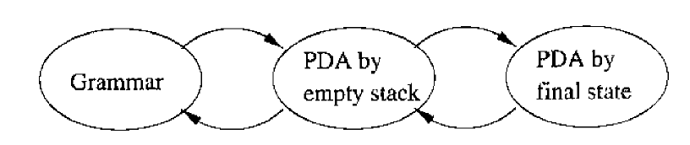
CFG s and PDAs
PDAs are the recognizing machines of the CFGs
Every CFG has an equivalent PDA
Every PDA has an equivalent CFG.

Slide 3
Idea of Converting a CFG into a PDA
The idea is to generate the left sentential forms the grammar uses to derive any particular string ‘w’.
The tail of each sentential form xAα with A appears on the stack top.
What is x???
x is the substring which is consumed from the input ‘w’ and the remaining will be available as the input.
For Ex:w=xy then x is the string that is consumed and y is the string left in the input for further scanning.

Slide 4
Idea of Converting a CFG into a PDA
Suppose PDA has the ID (q,y,Aα) representing the left sentential form xAα and if there is a production of the form A->β then we replace A with β
now we will have the id (q,y,βα)
(q,y,Aα)Ⱶ (q,y,βα) provided there is a production of the form A->β.
The generic algorithm will be
For each variable(Non Terminal) A
1. δ(q,ε,A) = (q,β) for every production | given A->β is a production in Grammar.
2. For each terminal a δ(q,a,a)=(q,ε).

Slide 5
Let us consider the CFG
I->a|b|Ia|Ib|I0|I1
E->I|E+E|E*E|(E)
The PDA will have only one state
P=({q},T, TUV,δ,q,S)
Compare this with the normal PDA definition
P={Q,∑,Γ,δ,q0,Z,F)
Note that the PDA obtained from CFG does not has a F because we are
attempting to create a PDA which accepts strings by empty stack

Slide 6
The transitions of the PDA for the CFG
δ(q,ε,I)={(q,a), (q,b), (q,Ia), (q,Ib), (q,I0), (q,I1)}
δ(q,ε,E)={(q,I), (q,E+E), (q,E*E), (q,(E)}
δ(q,a,a)=(q,ε)
δ(q,b,b)=(q,ε)
δ(q,0,0)=(q,ε)
δ(q,1,1)=(q,ε)
δ(q,+,+)=(q,ε)
δ(q,*,*)=(q,ε)
δ(q,(,()=(q,ε)
δ(q,),))=(q,ε)

Slide 7
Parsing the string a+b
y | A | α |  |  | X
a+b | E | ε |  |  | ε
a+b | E | + | E |  | ε
a+b | I | + | E |  | ε
a+b | a | + | E |  | ε
+b | + | E |  |  | a
b | E |  |  |  | a+
b | I |  |  |  | a+
b | b |  |  |  | a+b
ε | ε |  |  |  | accepted

Slide 8
Theorem 6.13
Theorem: if PDA P is constructed from CFG G using the above
construction then N(P)=L(G).
Proof : we prove that a string ‘w’ is in N(P) if and only if w is in N(G).
(if) if w is in L(G) then w has a left most derivation
S=>r₁=> r₂… r_{n}=w
We show by induction on I that (q,w,S) Ⱶ*(q,y_{i},α_{i})
Where y_{i} and α_{i} are the representations of the left sentential for r_{i}.
Let α_{i} be the tail of r_{i­} and let r_{i}=x_{i} α_{i.} then y_{i} is the string such that w=x_{i}y_{i}
Basis for i=1 (first left sentential form)
i=1; r₁=S ;
thus x₁ is ε i.e no symbols consumed till now. then w=y_{i}.
(q,w,S) Ⱶ (q,w,S) so by 0 moves the basis case is proved.

Slide 9
Theorem 6.13..
Induction:
We now consider the case of second and subsequent left sentential form.
We assume
(q,w,S) Ⱶ* (q,y_{i},α_{i}) and prove (q,w,S) Ⱶ* (q,y_{i+1},α_{i+1}).
Since α_{i} is a tail and it begins with the variable A and r_{i}->r_{i+1} is done by replacing A by one of its productions.
Once top of the stack is replaced then we are allowed to pop the terminals if the terminal in the input and the terminal in the stack top matches.
At one point α_{n}=ε since the tail of r_{n} is empty.(note r_{n} is the last left sentential form in the derivation)
(q,w,S) Ⱶ* (q,ε,ε) which means w is accepted.

Slide 10
Theorem 6.13..
Only if : if a String is accepted by PDA then it has a left most derivation(accepted by the CFG)
We start with an understanding that if a PDA pops out a variable ‘A’ from top of the stack without ever going below A then A derives what ever input was consumed from the input, in G.
(q,x,A) Ⱶ*(q,ε,ε) then A ->* x
The proof is on the induction if number of moves made by PDA.
Basis Case One move : This means input is consumed A-> ε in this case
x=ε

Slide 11
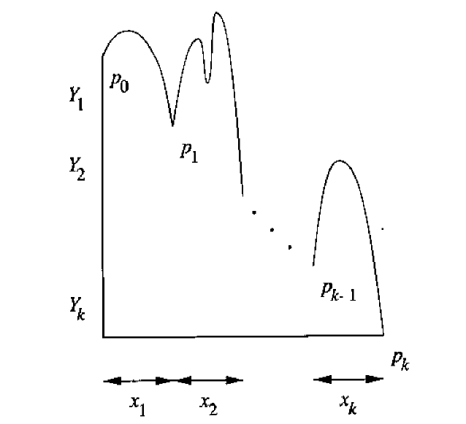
Theorem 6.13.. If PDA has n moves and n>1
The first move should be a push as pop can happen only when a match
for a terminal is found on the top of the stack.
Suppose the rule used is A-> Y₁ Y₂ .. Y_{k} where Y_{i} is either a terminal or a variable.
The next n-1 moves must consume the input x and will have its net effect on the stack (push or pop).
We break the input x into x₁x_{2..}x_{k} here x_{i} is a portion consumed by PDA each x_{i} is consumed and pops
Y_{i} until the Y₁ is popped out (remember Y₁ is the first symbol pushed to the stack and if this is popped
then the stack is empty).
The image shows how x₁x₂x₃ pops BaC

Slide 12
Theorem 6.13..
Formally we can conclude that (q,x_{i}x_{i+1}….x_{k},Y_{i})Ⱶ*(q,x_{i+1}....x_{k­},ε) for i=1,2,..k
Note : none of the moves can be more than n-1 so the inductive hypothesis applies if Y_{i} is a variable
Y_{i}->*x_{i}
If y_{i} is a terminal then there must be only one move involved and it matches x_{i} against Y_{i}
Here also we have Y_{i}->*x_{i}
and we say A ->Y₁ Y_{2….} Y_{k} ->* x₁Y₂……Y_{k} ->*…->*x₁x_{2 …}x_{k}
That is A->x.

